Slide 1

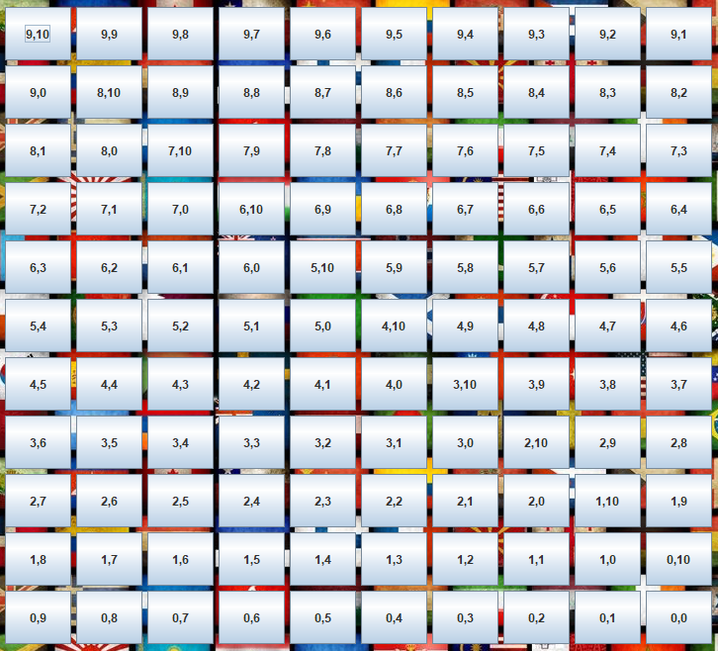
Jpanel(panneau) panneau.setLayout(new BorderLayout ());
Jmenu(mFichier)
Jpanel(pNord)
pNord.setLayout(new FlowLayout(FlowLayout.LEFT));
Jlabel (nomJoueur)
JmenuItem1
Jpanel(pOuest)
pOuest.setLayout(new FlowLayout(FlowLayout.RIGHT));
JmenuItem2
Jlabel(fondDemineur.png)
Jlabel (timer)
JmenuItem3
JPanel pCentre = new JPanel();
pCentre.setLayout(new GridLayout(nbFil,nbCol,SIZE1_BOUTTON, SIZE1 _BOUTTON));
pCentre.add(tMines[][])
Jpanel(pEst)
pEst.setLayout(new FlowLayout(FlowLayout.RIGHT));
Jlabel (scord)
Jbutton (tMines[nbFil][nbCol])
Jlabel (nbFil)
Jpanel(pSud1)
pSud1.setLayout(new FlowLayout(FlowLayout.LEFT));
Jlabel (nbCol)
Jpanel(pSud2)
pSud2.setLayout(new FlowLayout(FlowLayout.));
Jlabel (nbMin)

